Slide 1
DP technique

Slide 2
DP technique
Dynamic programming is computer programming optimization method.
The method was developed in the 1950s and has found applications in numerous fields, from aerospace engineering to economics.
It refers to simplifying a complicated problem by breaking it down into simpler sub-problems in a recursive manner.
The idea is to simply store the results of subproblems, so that we do not have to re-compute them when needed later. This simple optimization reduces time complexities from exponential to polynomial․

Slide 3
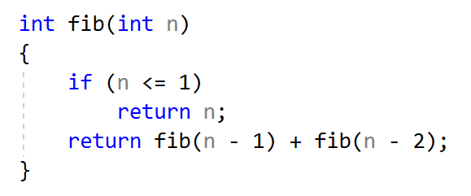

DP technique Example
Fibonacci numbers can be calculated both recursive and dp techniques. But let’s see the recursive version:
What is complexity of this function?
O($2^{n})$

Slide 4
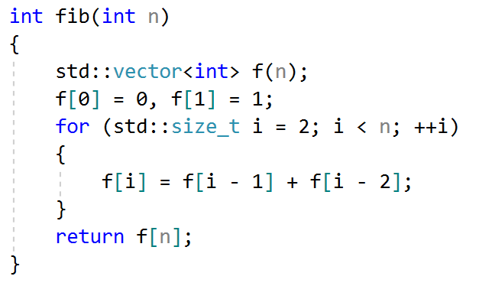

DP technique Example
And now let’s take a look to the dp version:
What is complexity of this function?
O(n$)$

